Slide 1
UNIVERSITY INSTITUTE OF COMPUTING
MASTER OF COMPUTER APPLICATIONS
PYTHON PROGRAMMING
DISCOVER . LEARN . EMPOWER

Slide 2
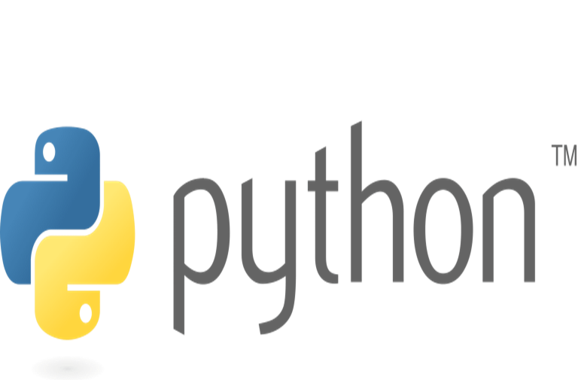
Contents
Introduction to Python Programming
Variables
Identifiers
Constants
Data types
Operators
Operator Precedence

Slide 3
Introduction to Python Programming
Python is a general-purpose, interpreted, object-oriented programming language.
Python was created by Guido van Rossum at National Research Institute for Mathematics and Computer Science, Netherlands in 1990 and was named after the popular British comedy troupe Monty Python’s Flying Circus.
Python is a general-purpose programming language.
Python is interpreted, which means that Python code is translated and executed by an interpreter, one statement at a time.

Slide 4
Introduction to Python Programming
Python is an object-oriented programming (OOP) language. Data in Python are objects created from classes. A class is essentially a type or category that defines objects of the same kind with properties and methods for manipulating objects.
Two versions of Python are currently coexistent: Python 2 and Python 3. The programs written in Python 3 will not run in Python 2. Python 3 is a newer version, but it is not backward-compatible with Python 2. This means that if you write a program using the Python 2 syntax, it may not work with a Python 3 interpreter.
Python provides a tool that automatically converts code written in Python 2 into syntax Python 3 can use. Python 2 will eventually be replaced by Python 3.

Slide 5
Introduction to Python Programming
Python 1.0 released on January, 1994.
Python 2.0 released on 16th Oct, 2000.
Python 3.0 released on 3rd Dec, 2008.
Python 3.10.2 released on 14th Jan, 2022 (latest version).

Slide 6
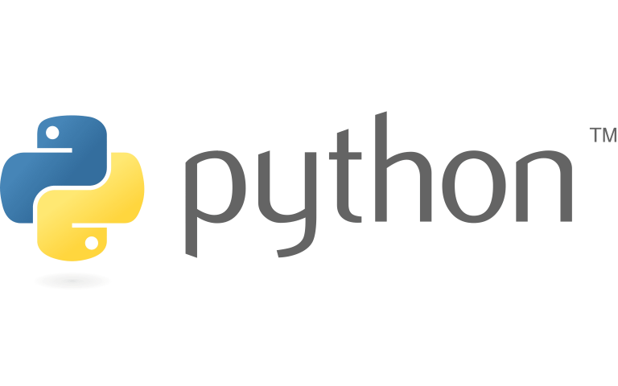
Introduction to Python Programming
 | Meaning and history The Python logo, designed by Tim Parkin. The emblem depicts a two-colored snakes image, which was based on the ancient Mayan drawings. They usually represented a python with a shortened tail and a big head. The Python wordmark in all the lowercase lettering is executed in a fine and elegant sans-serif typeface, where the upper parts of “T” and “H” are diagonally cut.

Slide 7
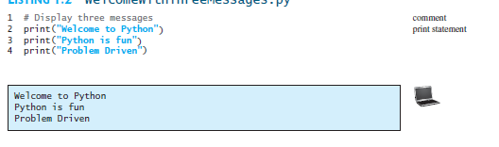
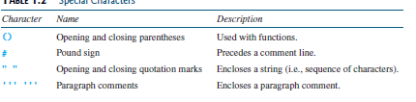
Introduction to Python Programming

Slide 8
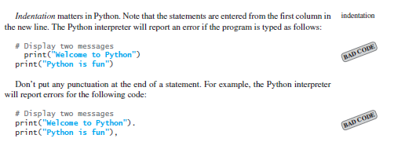
Introduction to Python Programming

Slide 9
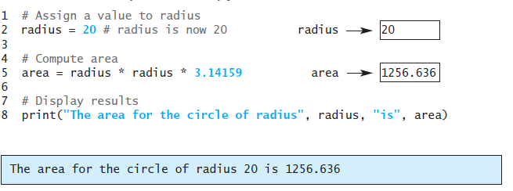
Introduction to Python Programming
Variable: Variable is a name that references a value stored in the computer’s memory. Variables such as radius and area reference values stored in memory. Every variable has a name that refers to a value

Slide 10
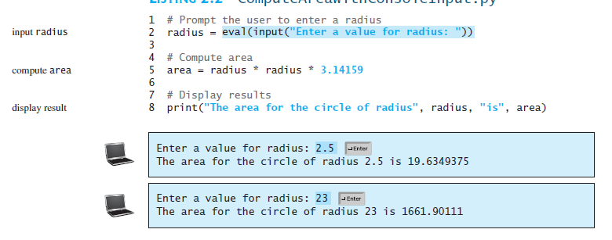
Introduction to Python Programming
Reading Input from console:
Reading input from the console enables the program to accept input from the user.
variable = input("Enter a value: ")

Slide 11
Introduction to Python Programming
Identifiers: Identifiers are the names that identify the elements such as variables and functions in a program.
All identifiers must obey the following rules:
An identifier is a sequence of characters that consists of letters, digits, and underscores (_).
An identifier must start with a letter or an underscore. It cannot start with a digit.
An identifier cannot be a keyword.
An identifier can be of any length.
Python is case sensitive, area, Area, and AREA are all different identifiers.

Slide 12
Introduction to Python Programming
Named Constants: A named constant is an identifier that represents a permanent value.
The value of a variable may change during the execution of a program, but a named constant (or simply constant) represents permanent data that never changes.
Python does not have a special syntax for naming constants.
If you have to change the constant’s value (e.g., from 3.14 to 3.14159 for PI), you need to change it only in a single location in the source code.
Descriptive names make the program easy to read.

Slide 13
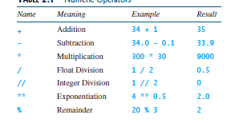
Introduction to Python Programming
Numeric Data Types : Python has two numeric types—integers and floating-point numbers—for working with the operators +, -, *, /, //, **, and %.

Slide 14
Introduction to Python Programming
Evaluating Expressions and Operator Precedence: Python expressions are evaluated in the same way as arithmetic expressions.
The following operator precedence rule is used to determine the order of evaluation.
Exponentiation (**) is applied first.
Multiplication (*), float division (/), integer division (//) , and remainder operators (%) are applied next. If an expression contains several multiplication, division, and remainder operators, they are applied from left to right.
Addition (+) and subtraction (-) operators are applied last. If an expression contains several addition and subtraction operators, they are applied from left to right.

Slide 15
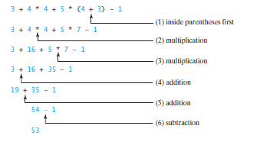
Introduction to Python Programming
Evaluating Expressions and Operator Precedence

Slide 16
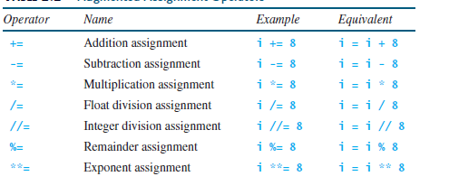
Introduction to Python Programming
Assignment Operators: The operators +, -, *, /, //, %, and ** can be combined with the assignment operator (=) to form augmented assignment operators.

Slide 17


Introduction to Python Programming
Type Conversions and Rounding: If one of the operands for the numeric operators is a float value, the result will be a float value.

Slide 18
Introduction to Python Programming
Strings and Characters: A string is a sequence of characters. Python treats characters and strings the same way.
String is a sequence of characters and can include text and numbers.
String values must be enclosed in matching single quotes (') or double quotes (").
Python does not have a data type for characters.
A single-character string represents a character. For example,
letter = 'A’ # Same as letter = "A"
numChar = ‘4’ # Same as numChar = "4"
Message = "Good morning" # Same as message = 'Good morning’
The first statement assigns a string with the character A to the variable letter. The second statement assigns a string with the digit character 4 to the variable numChar. The third statement assigns the string Good morning to the variable message.

Slide 19

Introduction to Python Programming
Reading Strings from the Console:
To read a string from the console, use the input function. For example, the following code reads three strings from the keyboard:
s1 = input("Enter a string: ")
s2 = input("Enter a string: ")
s3 = input("Enter a string: ")
print("s1 is " + s1)
print("s2 is " + s2)
print("s3 is " + s3)

Slide 20

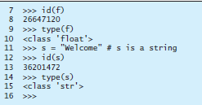
Introduction to Python Programming
Introduction to Objects and Methods: In Python, all data—including numbers and strings—are actually objects.
In Python, a number is an object, a string is an object.
Objects of the same kind have the same type.
The id function and type function to get these pieces of information about an object. For example,

Slide 21
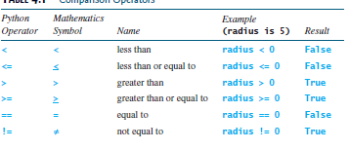
Introduction to Python Programming
Boolean Types, Values, and Expressions: A Boolean expression is an expression that evaluates to a Boolean value True or False.

Slide 22
Introduction to Python Programming
The result of the comparison is a Boolean value: True or False. For example, the following statement displays the result True:
radius = 1
print(radius > 0)
Variable holds a Boolean value is known as a Boolean variable. The Boolean data type is used to represent Boolean values. A Boolean variable can hold one of the two values: True or False.

Slide 23
THANK YOU

